Slide 1
Java 8 Stream
Java provides a new additional package in Java 8 called java.util.Stream.
This package consists of classes, interfaces and enum to allows functional-style operations on the elements.
We can use stream by importing java.util.Stream package.
Since past few versions, Java has started giving importance to concurrency. Java 8 goes one more step ahead and has developed a Streams API which lets us think about parallelism. Nowadays, because of the tremendous amount of development on the hardware front, multicore CPUs are becoming more and more general. In order to leverage the hardware capabilities Java had introduced Fork Join Framework. Java 8 Streams API supports many parallel operations to process the data, while completely abstracting out the low level multithreading logic and letting the developer fully concentrate on the data and the operations to be performed on the data.

Slide 2
Java 8 Stream
Most of us know, parallel processing is all about dividing a larger task into smaller sub tasks (forking), then processing the sub tasks in parallel and then combining the results together to get the final output (joining). Java 8 Streams API provides a similar mechanism to work with Java Collections. The Java 8 Streams concept is based on converting Collections to a Stream, processing the elements in parallel and then gathering the resulting elements into a Collection.
Process = Result of Task1
Task 1
Larger task
Final Output
Process = Result of Task2
Task 2

Slide 3
Java 8 Stream
Stream does not store elements. It simply conveys elements from a source such as a data structure, an array, or an I/O channel, through a pipeline of computational operations.
Stream is functional in nature. Operations performed on a stream does not modify it's source. For example, filtering a Stream obtained from a collection produces a new Stream without the filtered elements, rather than removing elements from the source collection.
Stream is lazy and evaluates code only when required.
The elements of a stream are only visited once during the life of a stream. Like an Iterator, a new stream must be generated to revisit the same elements of the source.
Starting from Java 8, the java collections will start having methods that return Stream. This is possible because of another cool feature of Java 8, which is default methods. Streams can be defiled as a sequence of elements from a source that supports aggregate operations. The source here refers to a Collection, IO Operation or Arrays who provides data to a Stream. Stream keeps the order of the data as it is in the source. Just like functional programming languages, Streams support Aggregate Operations. The common aggregate operations are filter, map, reduce, find, match, sort. These operations can be executed in series or in parallel.
The Streams also support Pipelining and Internal Iterations. The Java 8 Streams are designed in such a way that most of its stream operations returns Streams only. This help us creating chain of various stream operations. This is called as pipelining. The pipelined operations looks similar to a sql query.
In Java, we traditionally use for loops or iterators to iterate through the collections. These kind of iterations are called as external iterations and they are clearly visible in the code. Java 8 Stream operations has methods like foreach, map, filter, etc. which internally iterates through the elements. The code is completely unaware of the iteration logic in the background. These kind of iterations are called as internal iterations.
We can use stream to filter, collect, print, and convert from one data structure to other etc.

Slide 4
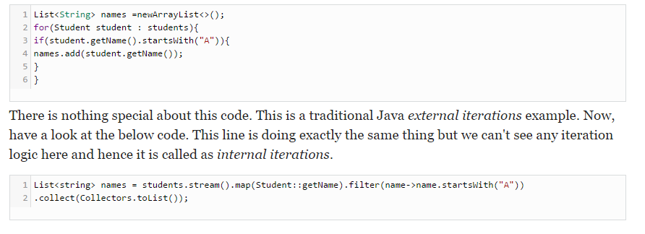
Java 8 Stream

Slide 5
Java 8 Stream
Collections vs. Streams
Collections are in-memory data structures which hold elements within it. Each element in the collection is computed before it actually becomes a part of that collection. On the other hand Streams are fixed data structures which computes the elements on-demand basis.
The Java 8 Streams can be seen as lazily constructed Collections, where the values are computed when user demands for it. Actual Collections behave absolutely opposite to it and they are set of eagerly computed values (no matter if the user demands for a particular value or not).

Slide 6
Java 8 Stream
https://docs.oracle.com/javase/8/docs/api/index.html?java/util/stream/Stream.html

